Slide 1
JS for Beginners
Class - 5

Slide 2
Last chapter Review…
Designing Database (schema)
Creating Logic Controllers for CRUD
API’s to connect Controller
Testing the API with POSTMAN

Slide 3
Class Objective
Stripping Website elements
Managing into smaller components
Send data to DB using form
Managing View Routes
Printing the Data from DB to EJS

Slide 4
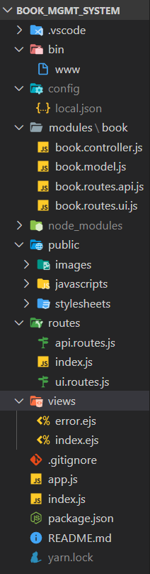
Last Class

Slide 5
Stripping Web Elements
Remove all the unnecessary elements from the website
Add the important JS and CSS files of the website to the public folder
PRO TIP: Use the cdn links for ease

Slide 6
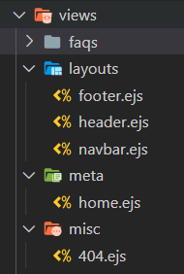
Smaller Components
Further divide the web components
Such as:
Layouts, navbar, header, meta and so on…

Slide 7
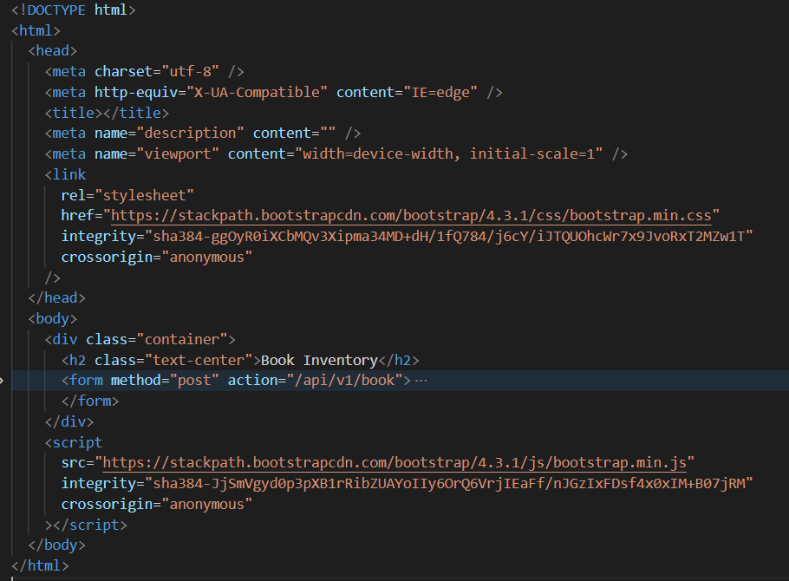
Sending methods
Use form to send the data to the API
Use method post & add url in action

Slide 8
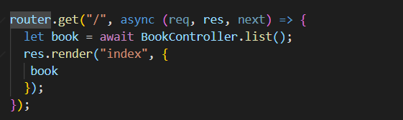
Managing UI Routes
Similar to API
Use the Method
Add the URL Path
Call the API controller
Send the data to the page

Slide 9
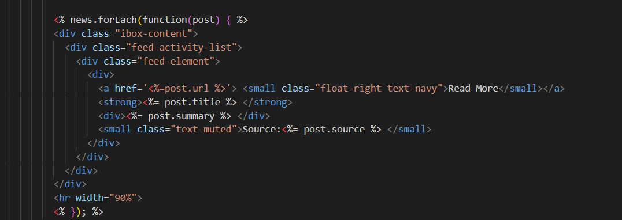
Print the Data in EJS
Find the recursive template
Use the <% %> to trigger the loop
Print the data using <%= %>

Slide 10
Q & A

Slide 11
Assignments
CREATE YOUR OWN ANY KIND OF
FULL CRUD APPLICATION

